Slide 1
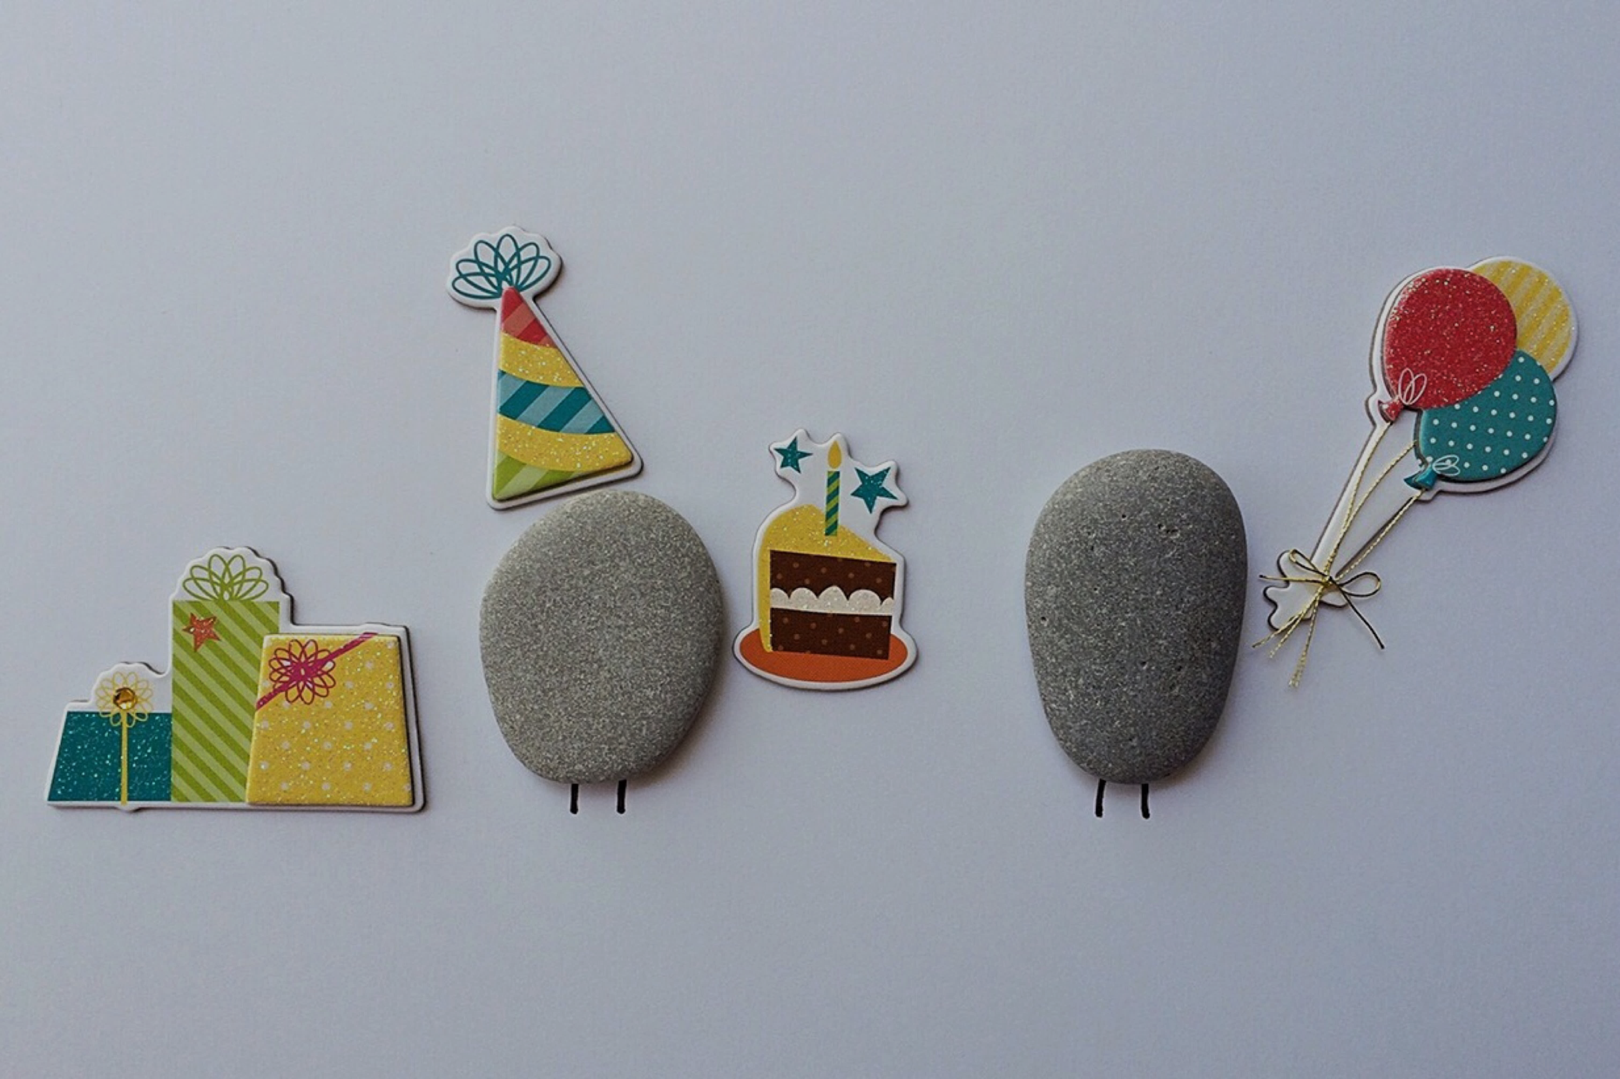
E-TALKING BEST FOR YOU
E-TALKING BEST FOR YOU
Birthday
Talking about days and dates, learn new words about months and dates
view

Slide 2

E-TALKING BEST FOR YOU
E-TALKING BEST FOR YOU
INTRODUCTION
Lesson goal:
Mastering “was born/were born”.

Slide 3
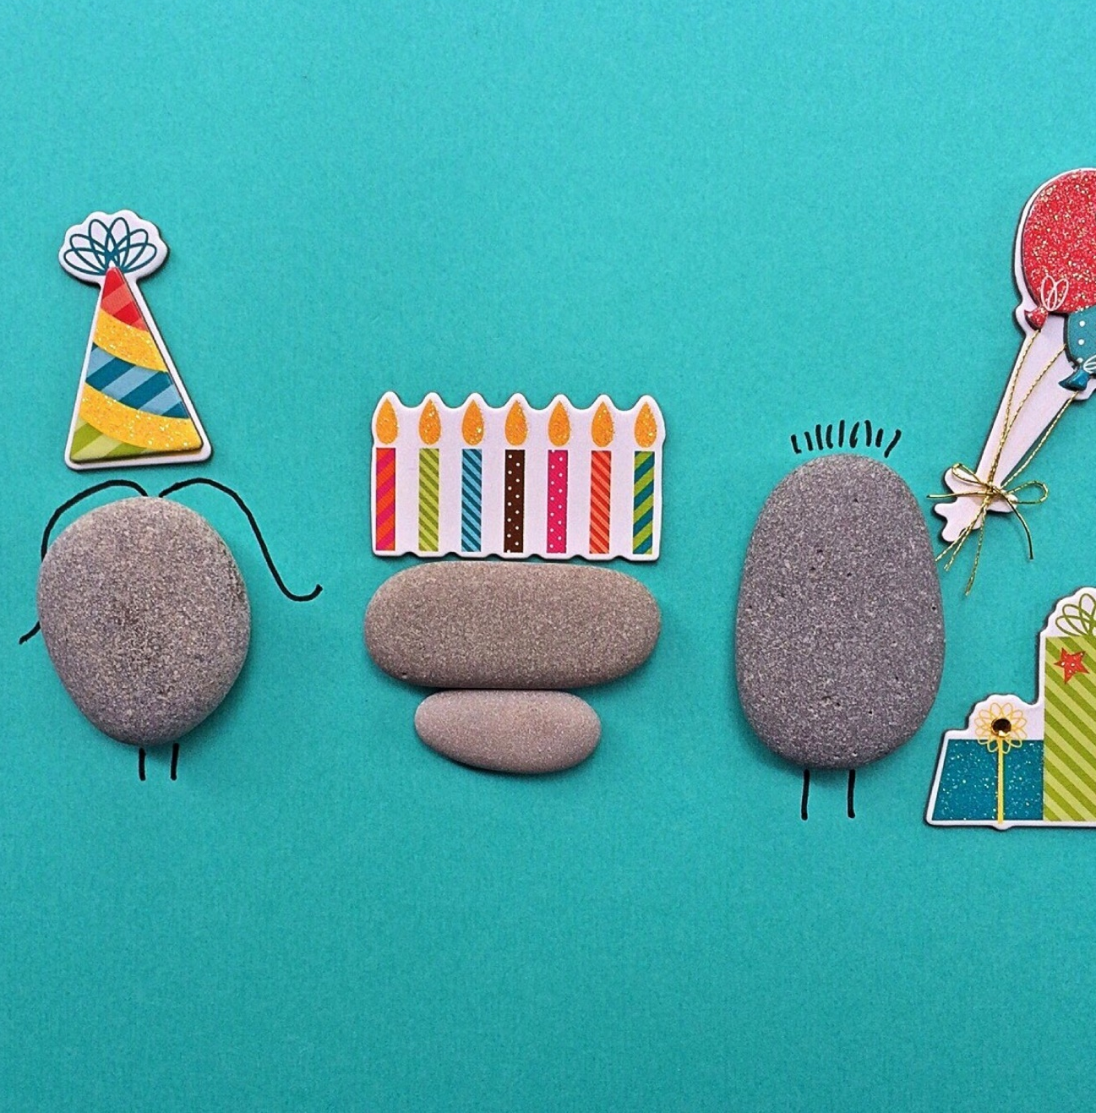
E-TALKING BEST FOR YOU
E-TALKING BEST FOR YOU
Birthdays.
START

Slide 4

E-TALKING BEST FOR YOU
E-TALKING BEST FOR YOU
WARM-UP
When is your birthday?
Did you celebrate your birthday last year?

Slide 5

E-TALKING BEST FOR YOU
E-TALKING BEST FOR YOU
GETTING STARTED
Say the following dates:
1. 1986/5/30
2. 2016/5/31

Slide 6
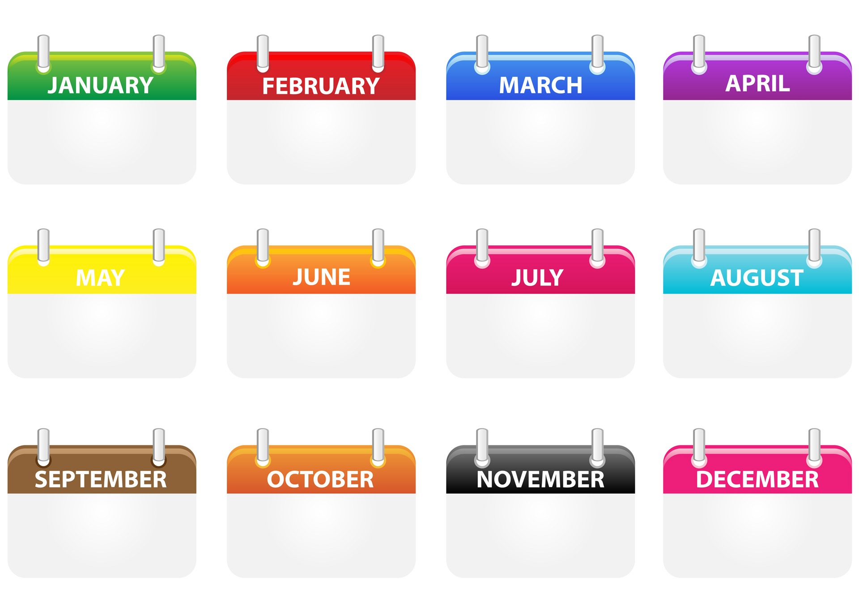
E-TALKING BEST FOR YOU
E-TALKING BEST FOR YOU
E-TALKING BEST FOR YOU
Months
8
4
10
6
1
2
9
7
11
12
3
5

Slide 7

E-TALKING BEST FOR YOU
Months
E-TALKING BEST FOR YOU
Practice
Practice saying the terms below and arrange them in order.

Slide 8
E-TALKING BEST FOR YOU
E-TALKING BEST FOR YOU
E-TALKING BEST FOR YOU
Dates
1st first 2nd second 3rd third 4th fourth 5th fifth 6th sixth
7th seventh 8th eighth 9th ninth 10th tenth 11th eleventh 12th twelfth
20th twentieth 21st twenty-first 30th thirtieth

Slide 9

E-TALKING BEST FOR YOU
Time phrases
E-TALKING BEST FOR YOU
Practice
Read the dates listed above and say the following dates:
1. May 4th
2. December 22nd
2

Slide 10
E-TALKING BEST FOR YOU
E-TALKING BEST FOR YOU
Grammar: was born/ were born
E-TALKING BEST FOR YOU
1. Where _____ Angelina born?
She ____ born in London.
2. When ______ they born?
They _____ born in 1991.

Slide 11
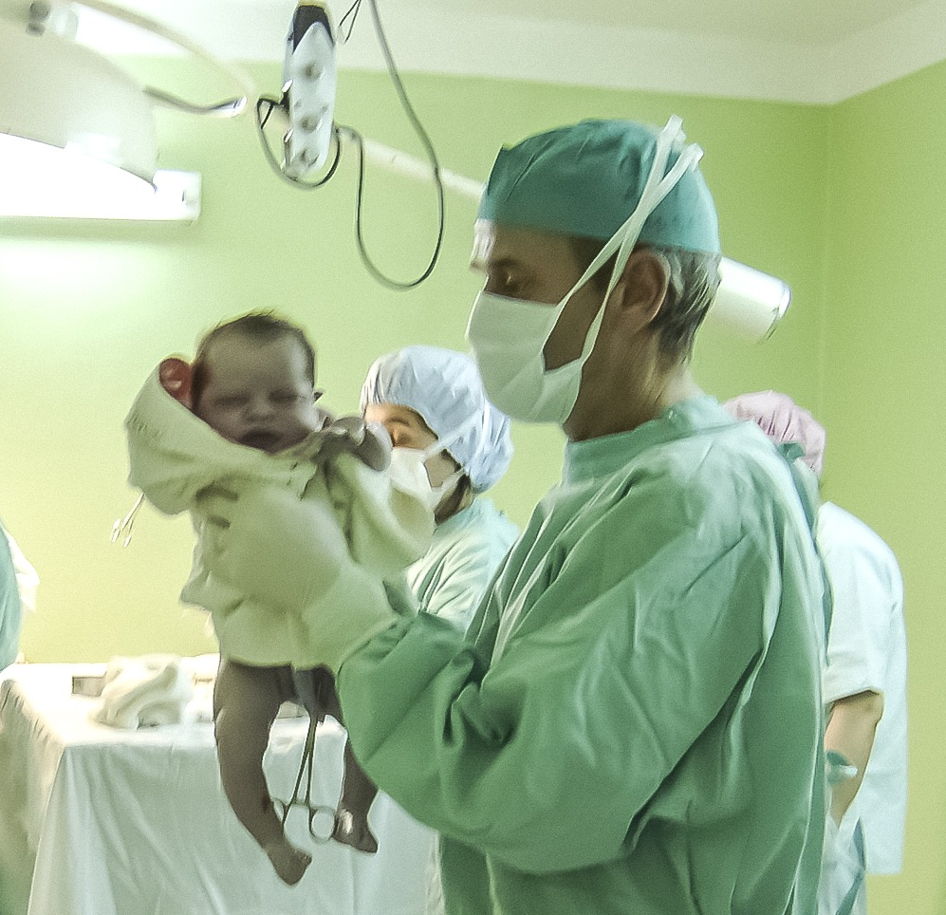
E-TALKING BEST FOR YOU
Grammar: was born/ were born
E-TALKING BEST FOR YOU
Practice
Make sentences about yourself.

Slide 12
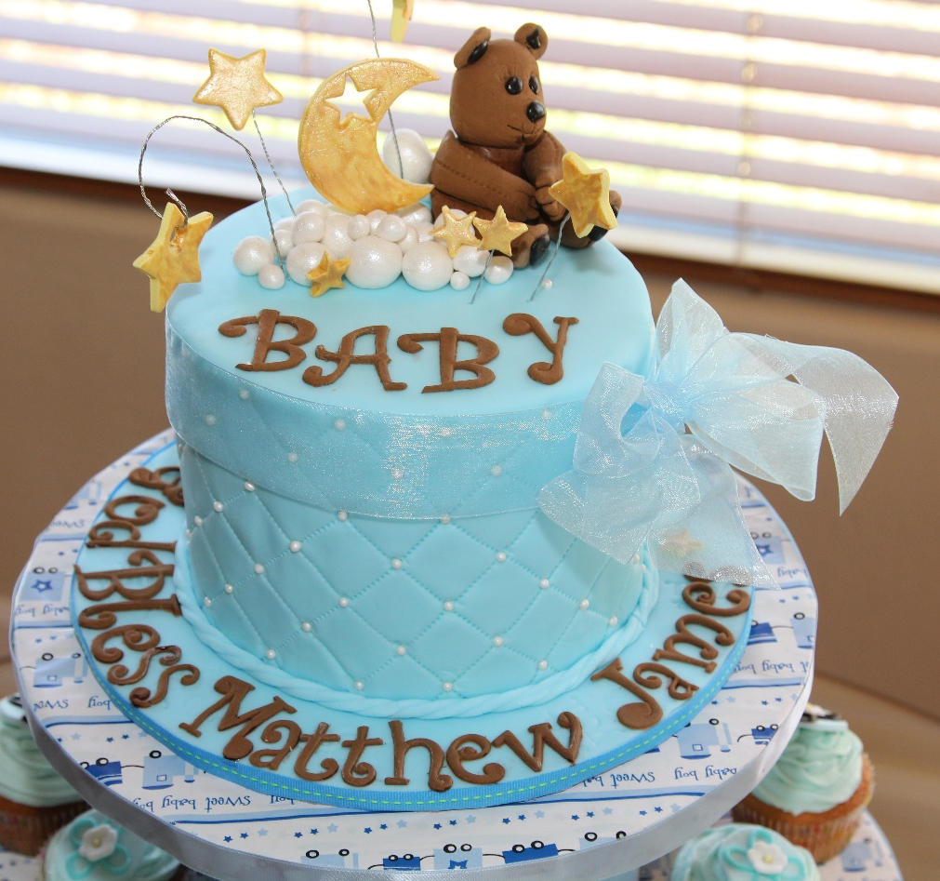
E-TALKING BEST FOR YOU
E-TALKING BEST FOR YOU
Conversation- Asking Birthdays
E-TALKING BEST FOR YOU
A: When is your birthday, Adele?
B: It’s on May 20th. What about yours?
A: My birthday’s on May 22nd.

Slide 13

E-TALKING BEST FOR YOU
Conversation- Asking Birthdays
E-TALKING BEST FOR YOU
Practice
When is your birthday?

Slide 14
E-TALKING BEST FOR YOU
E-TALKING BEST FOR YOU
E-TALKING BEST FOR YOU
Conversation- Suggestions
Fill in : do, meet, idea, seven, don’t, time, we
A: What shall we do this evening?
B: Let’s go to a club.
A: No, I ________ think so. Why don’t _____ go to the cinema?
B: Sure, where shall we ___________?
A: Let’s meet at the cinema.
B: What ________ shall we meet?
A: About _________ thirty.

Slide 15
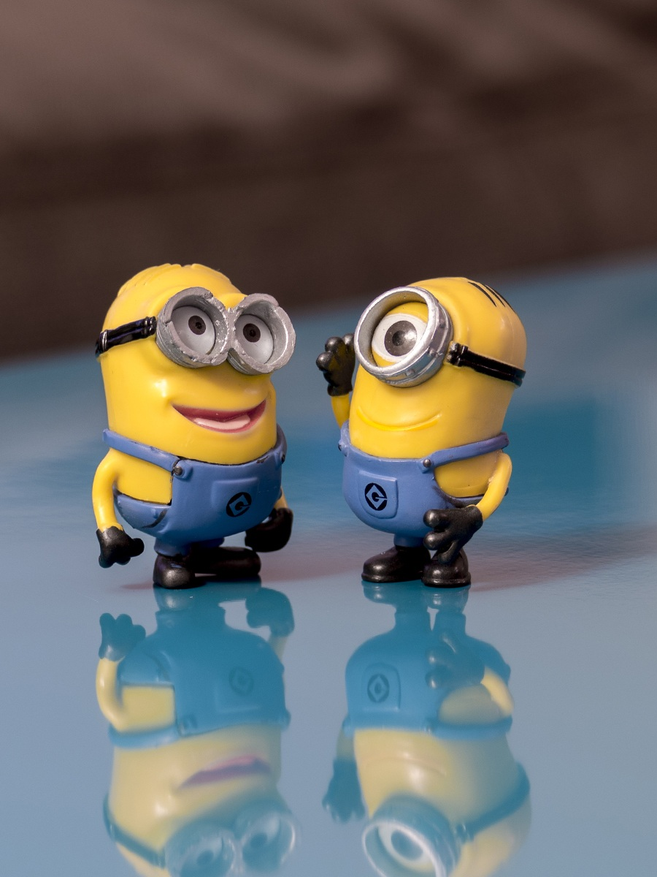
E-TALKING BEST FOR YOU
E-TALKING BEST FOR YOU
Conversation- Suggestions
Practice
Practice the conversation listed above.

Slide 16

E-TALKING BEST FOR YOU
E-TALKING BEST FOR YOU
SPEAKING TASK
Do you like to celebrate your birthday?

Slide 17

E-TALKING BEST FOR YOU
E-TALKING BEST FOR YOU
ASSESSMENT
Answer the following questions:

Slide 18

E-TALKING BEST FOR YOU
E-TALKING BEST FOR YOU
1. Where were you born?
2. Did you celebrate your birthday last year?
ASSESSMENT

Slide 19


E-TALKING BEST FOR YOU
E-TALKING BEST FOR YOU
Thank you !
See you tomorrow

